Slide 1
Input and Output in Java Lecture - 7
Prepared By - Rupali Patil

Slide 2
Contents
Standard Streams
Scanner Class
Types of Streams
Byte Stream vs Character Stream
Command Line arguments

Slide 3
Standard Streams
System.in –read from KB
System.out-display data on console
System.err-display error messages
import java.lang.*;
java.lang

Slide 4
System.out
System.out is a PrintStream to which you can write characters.
It outputs the data you write to the console.
System.out.print()
System.out.println()
System.out.printf ()

Slide 5
System.in
System.in is an InputStream which is connected to keyboard
Java application read input through keyboard using System.in
Scanner class
BufferedReader class

Slide 6
Scanner Class
We can read java input from System.in using Scanner class
It is available in the java.util package.

Slide 7
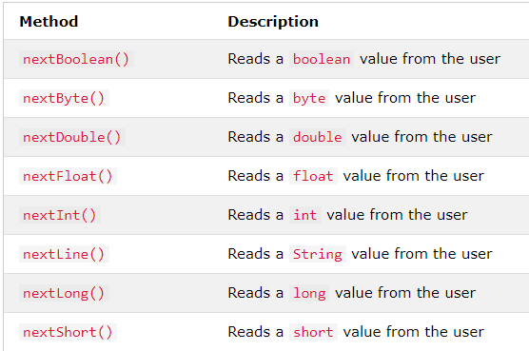
Input Types in Scanner Class

Slide 8
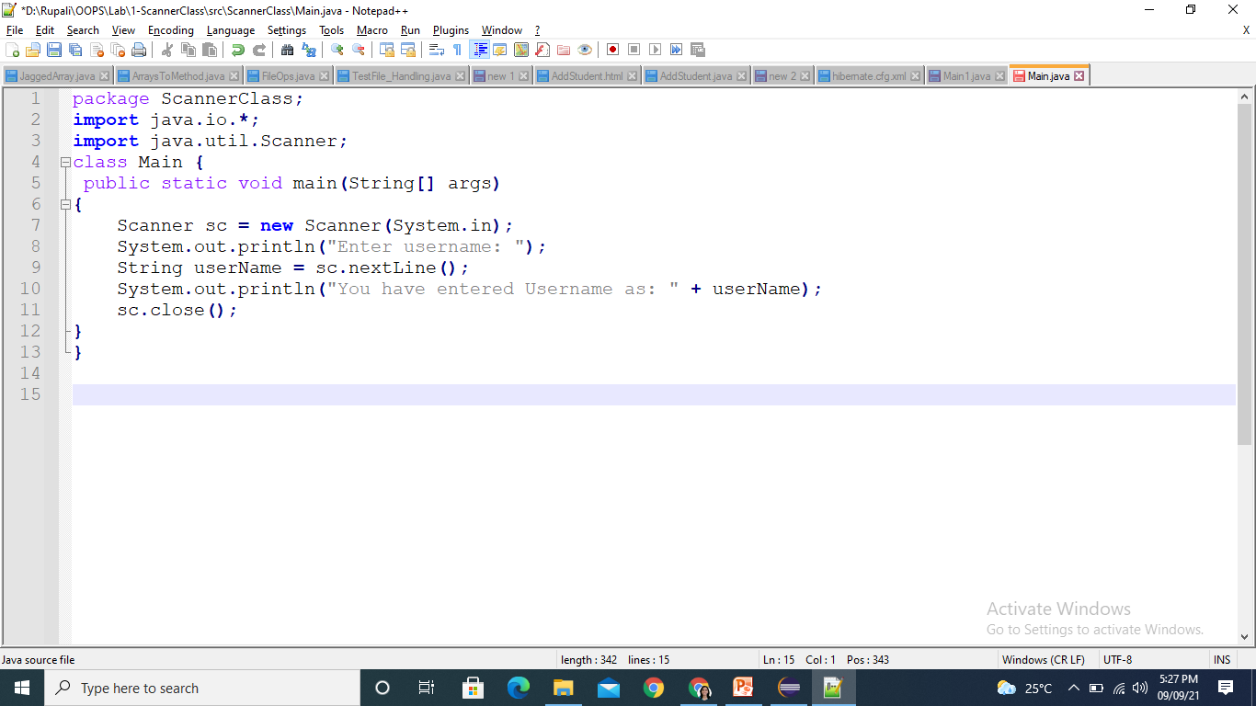
Example using Scanner Class
Program to accept name as an input from User and display onto console.

Slide 9
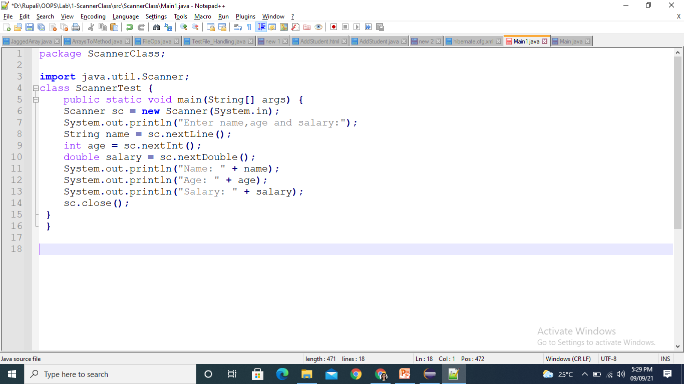
Example using Scanner Class
Program to accept name ,age and salary as an input from User and display onto console.

Slide 10
Types of Streams
What is Stream:
continuous flow of data/sequence of data.
OR
Stream is a logical connection between a java application and source-destination, through which we read data from a source and can store data into a destination .

Slide 11
Types of Streams contd..
Modern version of Java define two types of streams: byte and character
Byte Stream: Provide convenient means for handling input and output of bytes
Character Stream: Designed for handling input and output of characters

Slide 12
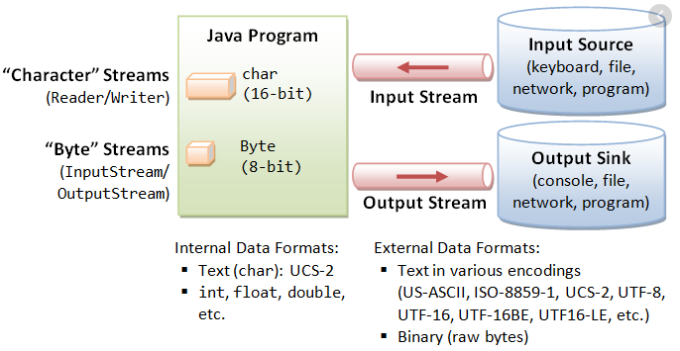
Types of Streams contd..

Slide 13
Byte Stream vs Character Stream
Byte Stream | Char Stream
Reads data byte by byte | Read data character by character
Used for inputting and outputting the bytes | Used for inputting and outputting the char
Two classes :InputStream and OutputStream | Two classes :Reader and Writer

Slide 14


IO Hierarchy
Stream
Byte Stream
Char Stream
InputStream
OutputStream
Reader
Writer
Read ()
Write ()

Slide 15
Command Line arguments
It is an argument passed at the time of running the java application.
The arguments passed from the console can be received in the java program and it can be used as an input.
A Java application can accept any number of arguments from the command line.
The user enters command-line arguments when invoking the application and specifies them after the name of the class to be run.
For example, suppose a Java application called Sort sorts lines in a file. To sort the data in a file named friends.txt, a user would enter: java Sort friends.txt

Slide 16
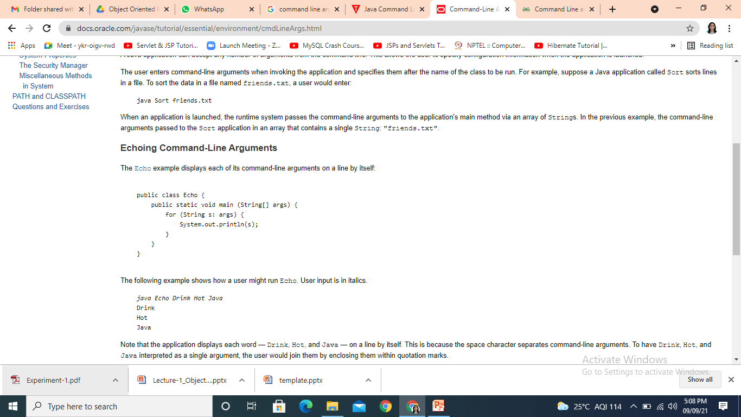
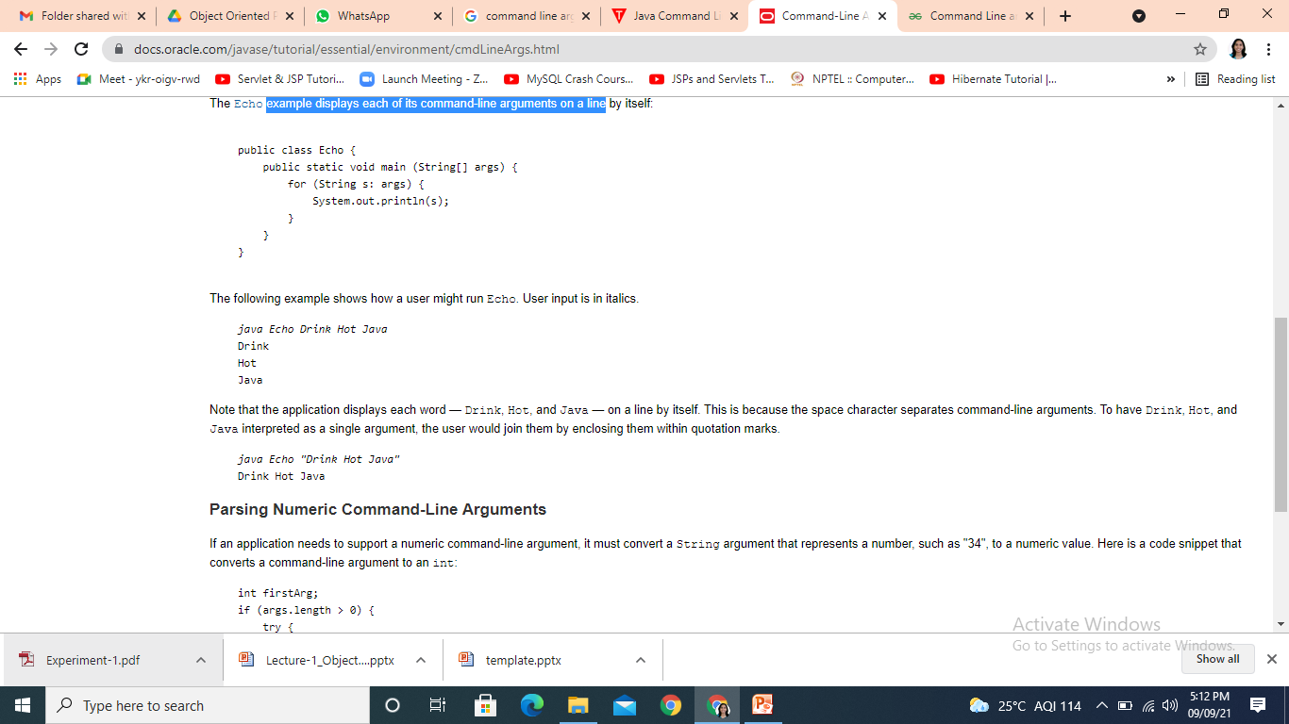
Command Line arguments contd..
When an application is launched, the runtime system passes the command-line arguments to the application's main method via an array of Strings.
Example:
Output

Slide 17
Thank You

